Slide 1

Linear Regression
By Alex Joslin

Slide 2
What is Linear Regression
A supervised machine learning algorithm
A statistical model for evaluating the relationship between a dependent variable and an independent variables (also called predictors, covariates or features)

Slide 3

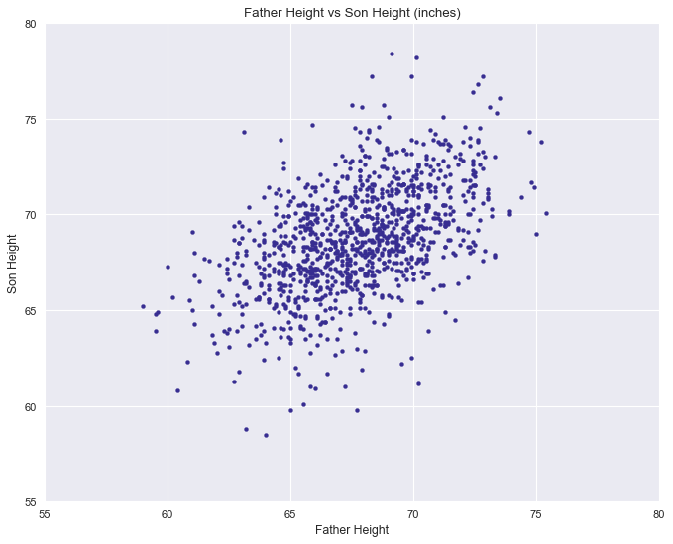
1078 Rows
of Data
5ft
6ft

Slide 4
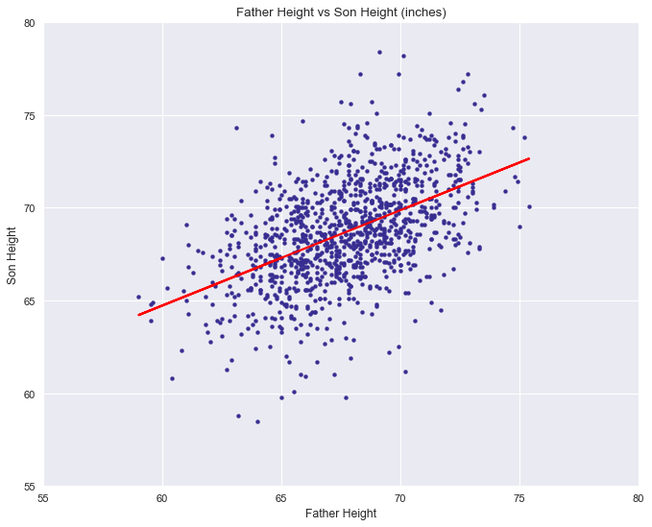
1078 Rows
of Data
5ft
6ft

Slide 5
Dealing with outliers

Slide 6
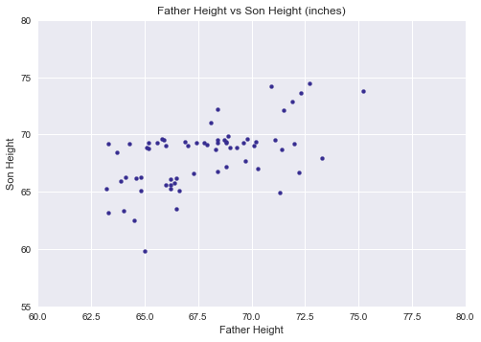


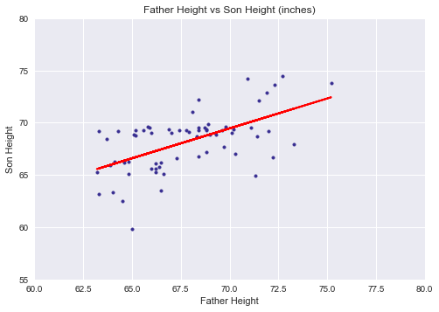
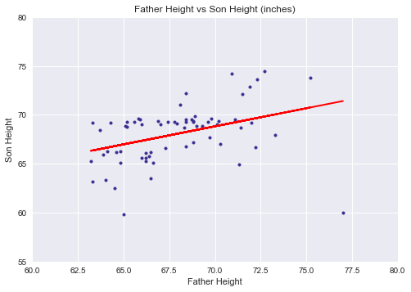
65 rows of data
outlier
outlier

Slide 7
Methods of identifying outliers
Checking if data point is above Q3 + 1.5(IQR) or below Q1– 1.5(IQR)
https://www.youtube.com/watch?v=9aDHbRb4Bf8
Standard Residuals
Cook’s Distance
Any many more

Slide 8
Regression Line

Slide 9

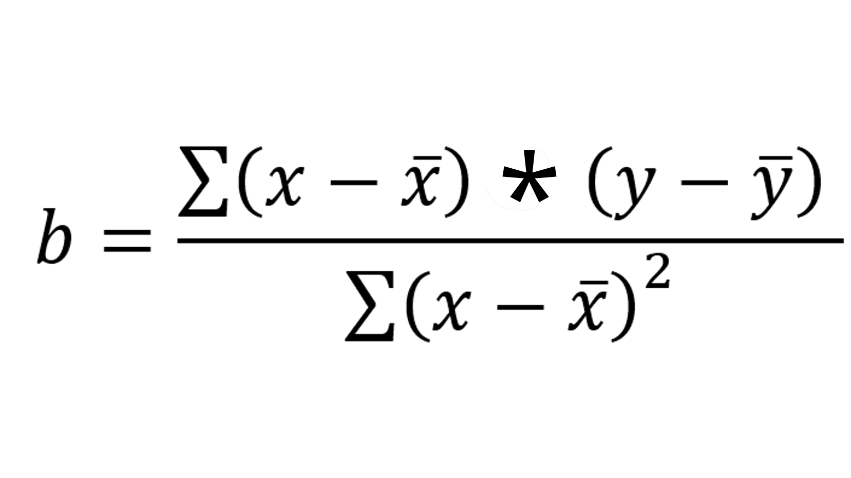
Calculation
The sum of all squared distances
of each point to the line

Slide 10
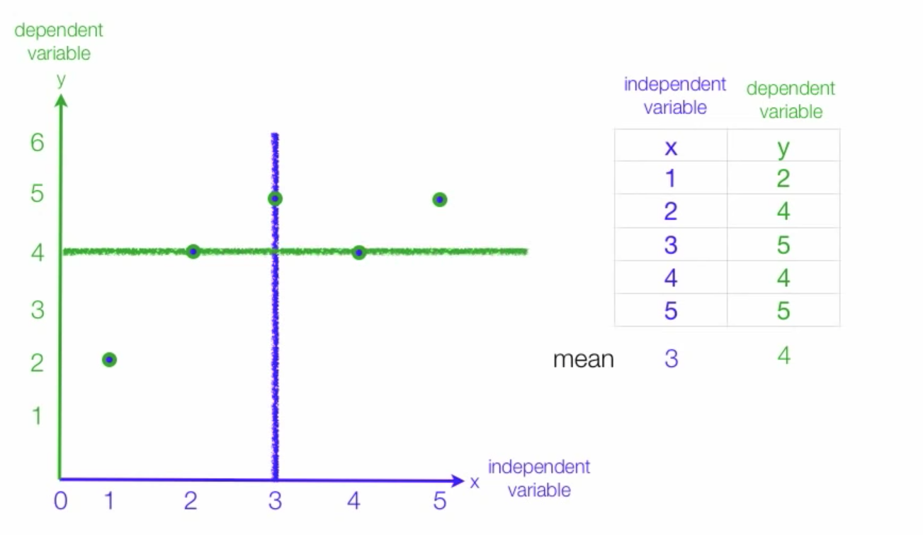
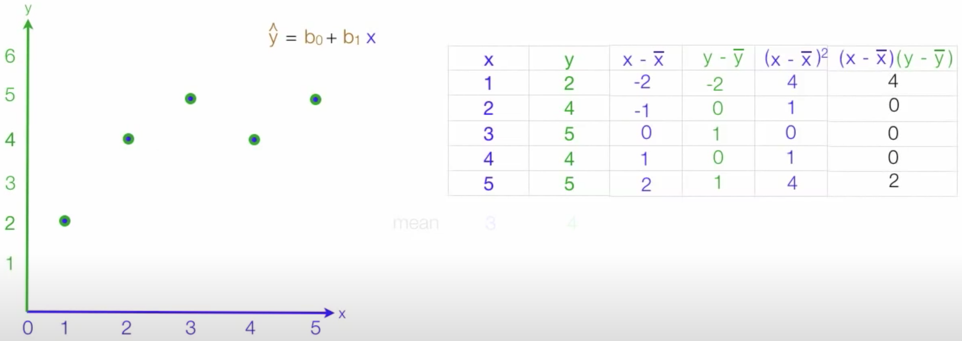
mean 3 4

Slide 11
Other types of Regressions
Lasso Regression
Multiple Regression
Polynomial Regression
Logistic Regression
Ridge Regression
Poisson Regression
Stepwise Regression

